Slide 1
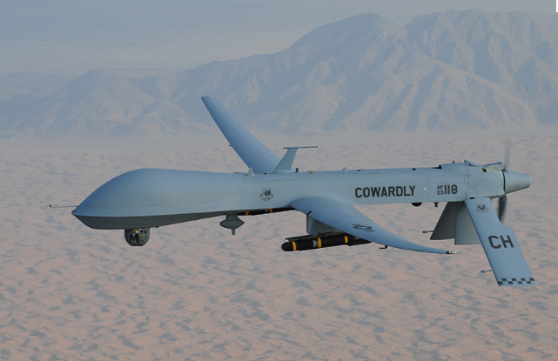
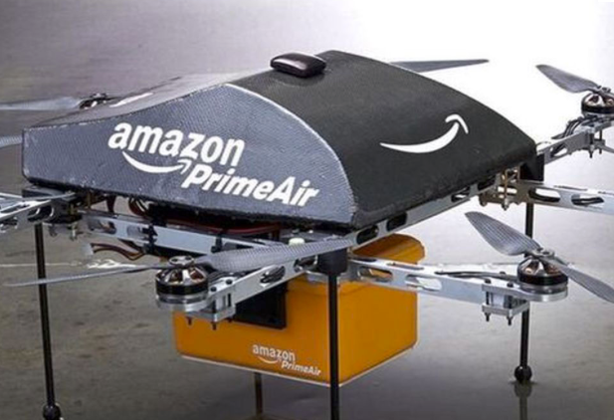
DRONES M.DRUMARE

Slide 2
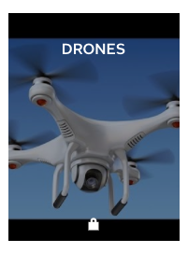
ON FLIPBOARD
http://flip.it/zFTbQk

Slide 3
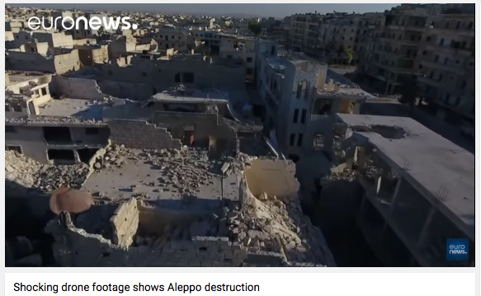
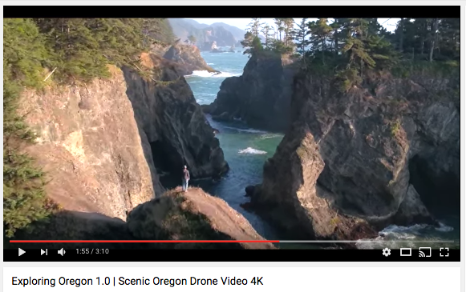

Slide 4
WHAT ?

Slide 5
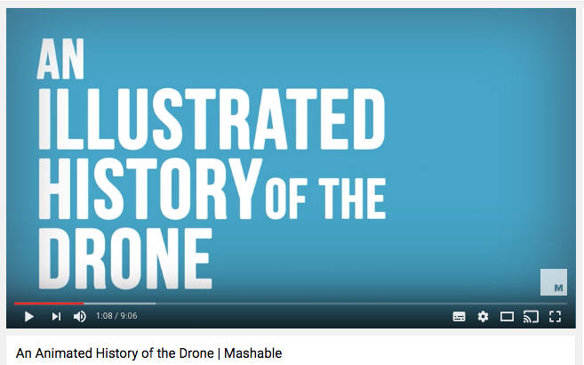
UAV, UAS, DRONES
A drone, in a technological context, is an unmanned aircraft.
Drones are more formally known as unmanned aerial vehicles (UAVs) or unmanned aircraft systems (UASes).
The aircrafts may be remotely controlled or can fly autonomously through software-controlled flight plans in their embedded systems embedded systems working in conjunction with onboard sensors and GPS.

Slide 6
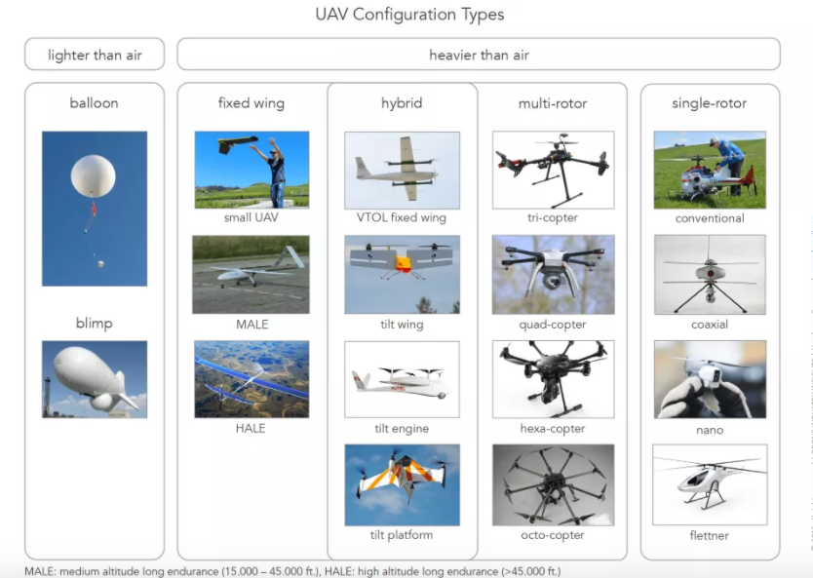
UAVs CONFIGURATION TYPE

Slide 7
UAVs CLASSIFICATION
UAVs typically fall into one of six functional categories:
Target and decoy – providing ground and aerial gunnery a target that simulates an enemy aircraft or missile.
Reconnaissance – providing battlefield intelligence.
Combat – providing attack capability for high-risk missions.
Logistics – delivering cargo.
Research and development – improve UAV technologies.
Civil and commercial UAVs – agriculture, aerial photography, data collection.

Slide 8
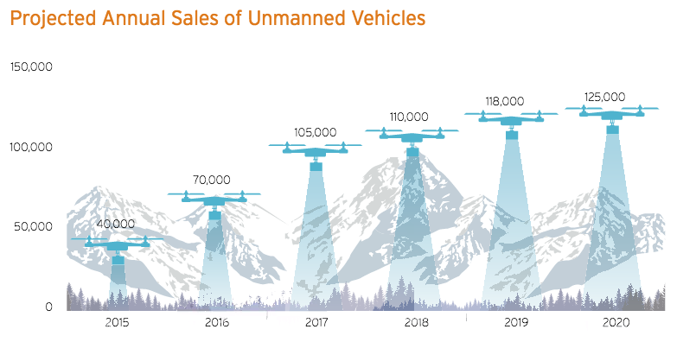
UAV BOOMING

Slide 9
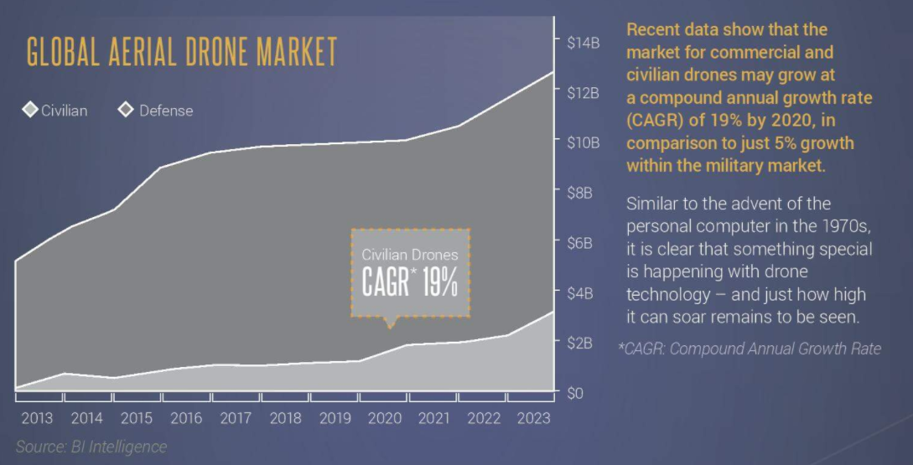
UAV BOOMING

Slide 10
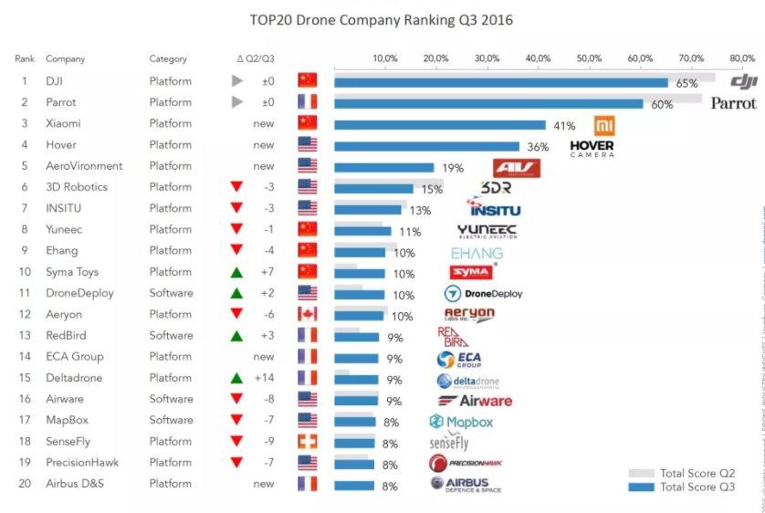
DRONES COMPANY RANKING

Slide 11
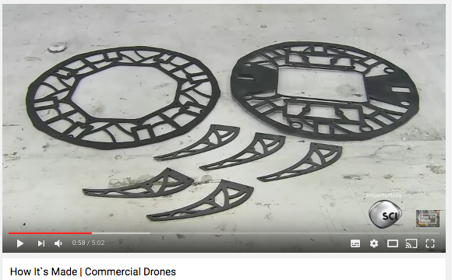
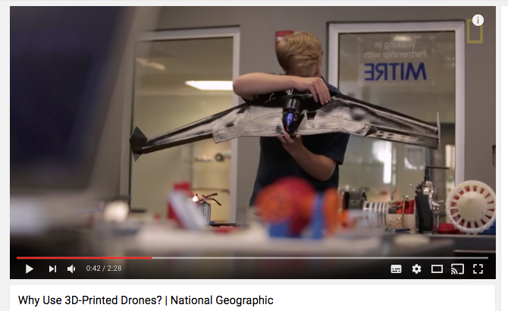
3D PRINTED DRONES
A crash for a typical model aircraft can mean disaster in the form of dollar signs and hours of labor.
3-D printing allows quick modifications and the rapid creation of replacement parts at a lower price.

Slide 12
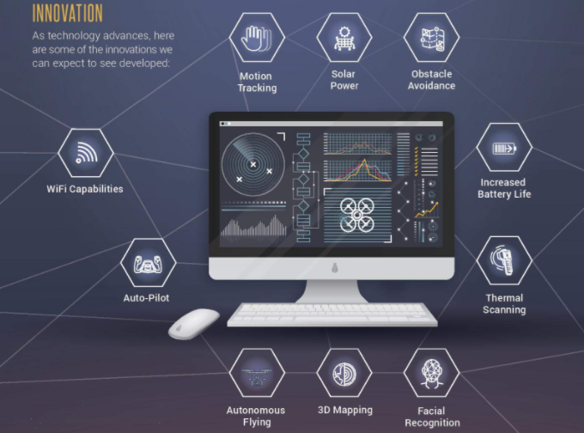
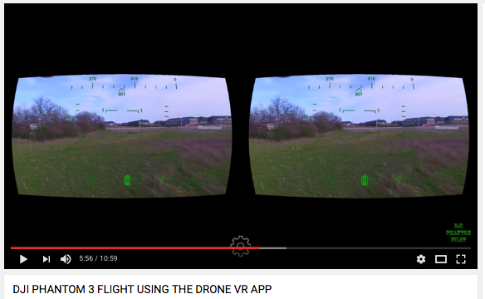
INNOVATION AND DRONES

Slide 13
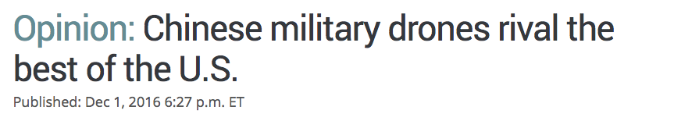
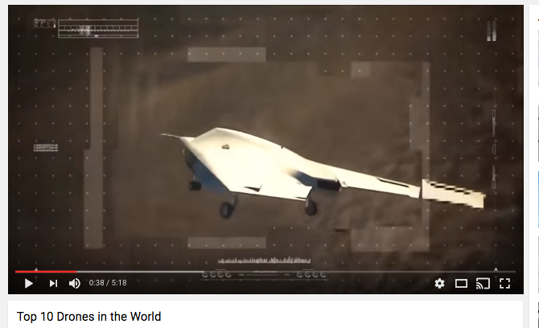
MILITARY DRONES
Chinese drones are cheap and readily available. For about $4 million, the price of a single U.S.-made MQ-1 Predator, one could buy four Chinese Wing Loong units.
Chinese UAVs are generally less capable in terms of performance
U.S. has severely limited export options of its own drone technology to allies and other countries. Those countries in many cases have no other choice but to turn to China.

Slide 14
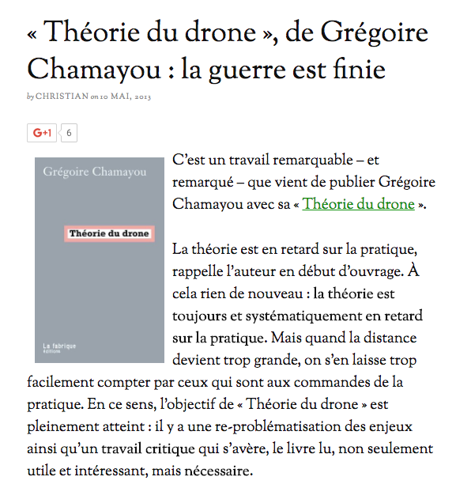
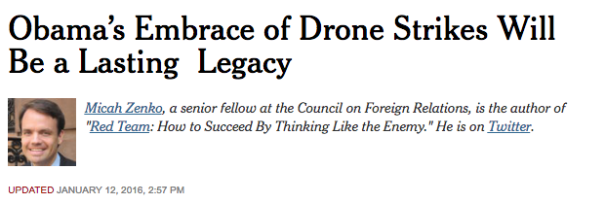
LA THEORIE DU DRONE
Obama’s embrace and vast expansion of drone strikes against militants and terrorists will be an enduring foreign policy legacy.
Whereas President George W. Bush authorized approximately 50 drone strikes that killed 296 terrorists and 195 civilians in Yemen, Pakistan and Somalia.
Obama has authorized 506 strikes that have killed 3,040 terrorists and 391 civilians.

Slide 15
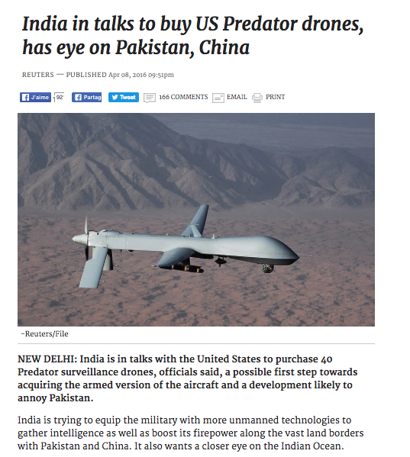
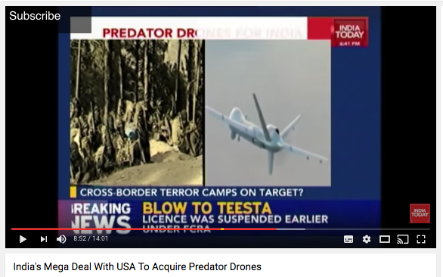
THE PREDATOR

Slide 16
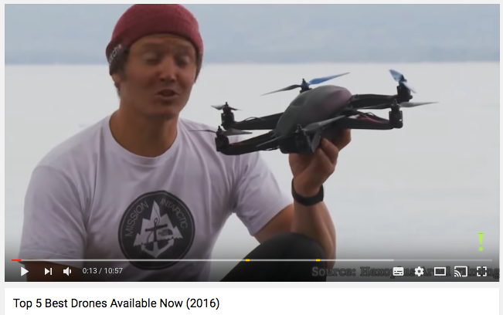
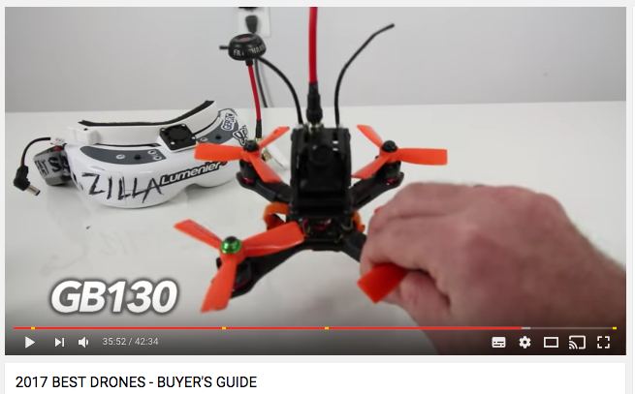
CONSUMER DRONES
Altitude: 0 to 20 metres
Most are little more than toys, piloted with smartphone apps or gaming-style controllers and flying just a few metres and minutes between charges.
Pricier models come with built-in cameras, automatic stabilisation, longer range, and bigger batteries.
Smart features like collision avoidance and “follow me” modes will soon become available on lower cost drones.
Types of drones: Quadcopters.
Companies involved:DJI, Parrot, Yuneec, Horizon, GoPro.

Slide 17
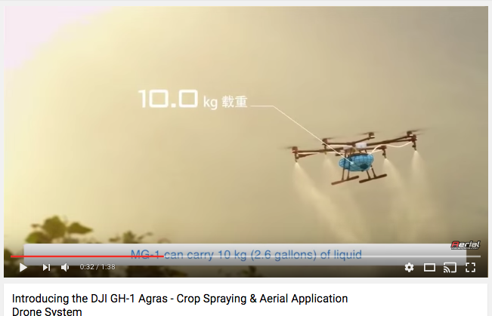
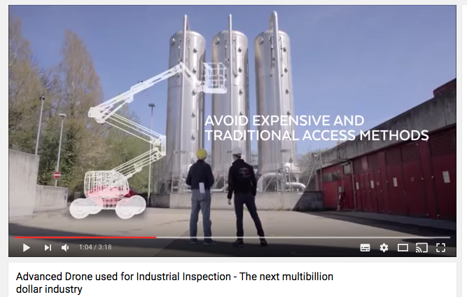
COMERCIAL DRONES
Altitude: 20 to 50 metres
These more capable drones : allowing firefighters to target blazes or farmers to spot blighted crops.
They usually require a trained pilot to fly them, within visual range only, and still have relatively limited flight times.
Commercial drones are expected to become an industry worth more than $5bn (£4bn) by 2020, with gradually relaxing regulations allowing even small businesses to operate them.
Types of drones: Quadcopters and fixed wing, propeller.
Companies involved:DJI, senseFly, QuestUAV, Insitu, Microsoft.

Slide 18
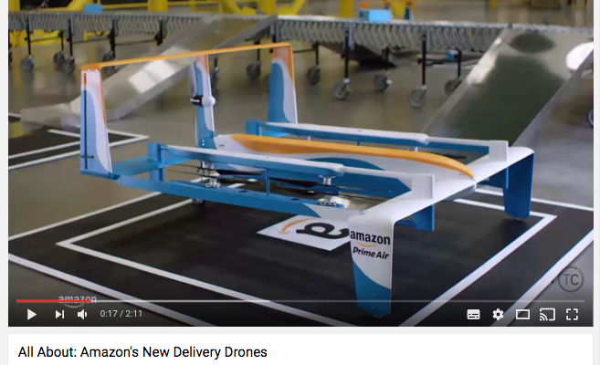
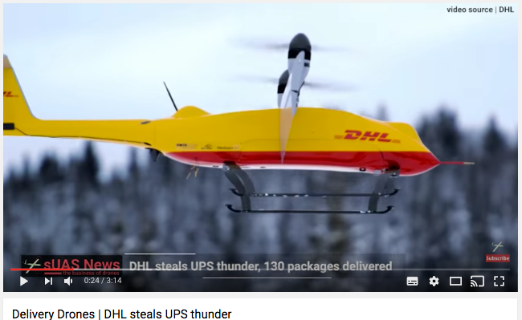
DELIVERY DRONES
Altitude: 50 to 120 metres
Drones that fly beyond the operator's line of sight, or over long ranges, must have the ability to plan routes, avoid other flying objects, and land themselves safely.
Amazon has proposed a dedicated high-speed transit zone just above 120m, allowing delivery drones to zip between warehouses and homes.
Nasa is slowly developing an automated air traffic control system for autonomous drones and hopes to test an operational system by 2018.
Types of drones: Fixed wing, propeller.
Companies involved:Amazon, Google, UPS, DHL, CyPhy Works.

Slide 19
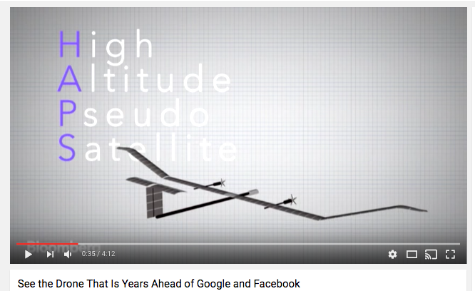
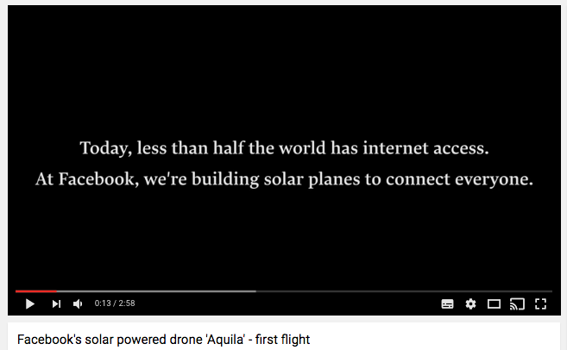
SOLAR DRONES
Altitude: 10km to 30km
Facebook and Google are testing solar-powered drones that can remain aloft for weeks at a time.
Facebook’s Aquila drone provides wireless connectivity for remote areas and developing countries.
Google is working towards next-generation high-speed 5G data.
Types of drones:Fixed wing, conventional and solar-powered.
Companies involved: Facebook, Google, Airbus, Boeing, SolarStratos.

Slide 20
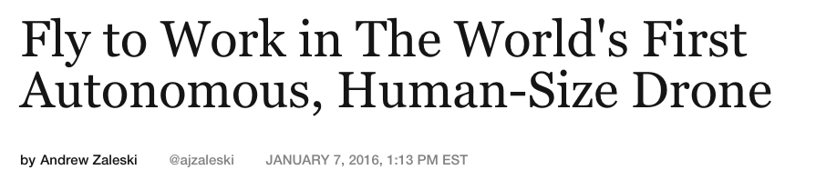
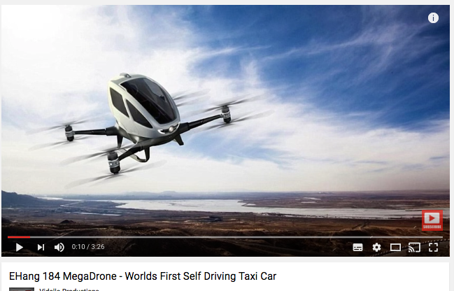
BEYOND THE DRONE : EHang 184
Chinese drone manufacturer EHangunveiled the EHang 184, the first fully electric autonomous aerial vehicle capable of carrying one passenger up to 220 pounds over short distances.
Travel is controlled mostly by an onboard tablet inside the pod-like cockpit.

Slide 21
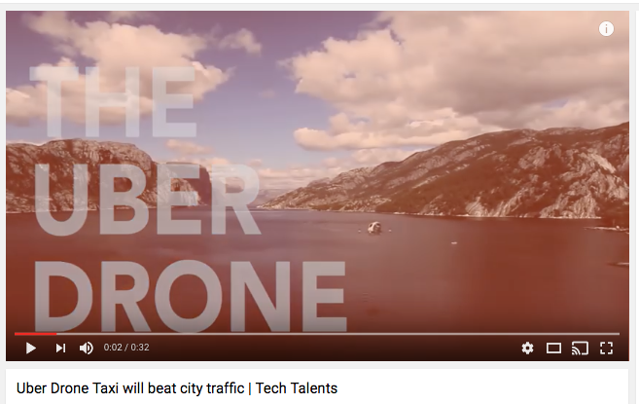
BEYOND THE DRONE : UBER
Uber drone taxi.
Uber has been pioneering self-driving technology for a while now, debuting the first self-driving taxis in Pittsburgh (august 2016) last month.
The ride share company wants to push the challenge higher with a Uber drone taxi (end 2017).

Slide 22
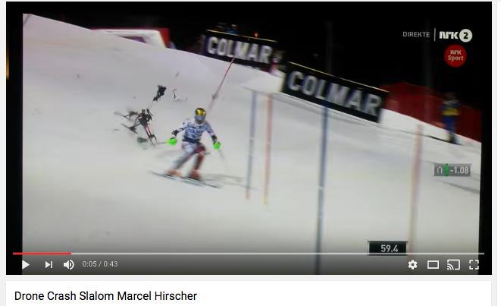
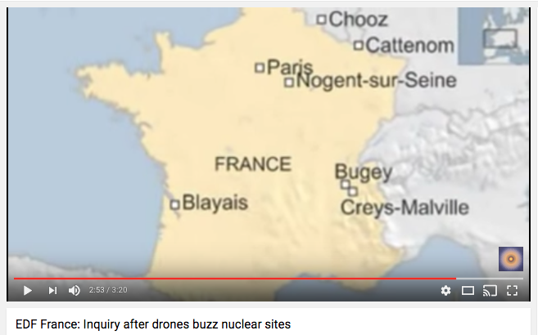
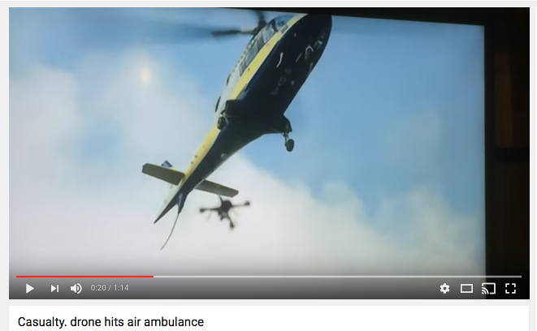
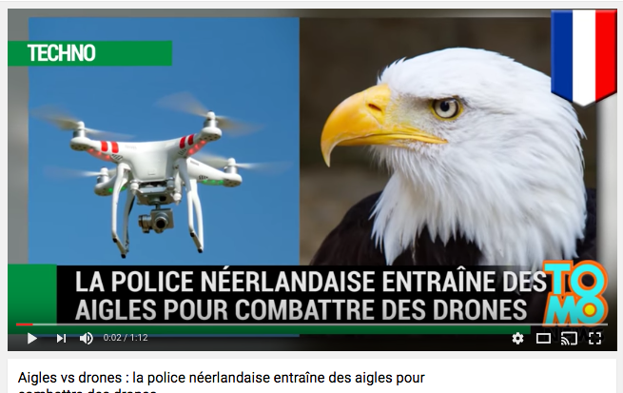
SECURITY ISSUE : CRASH AND TERRORISM

Slide 23
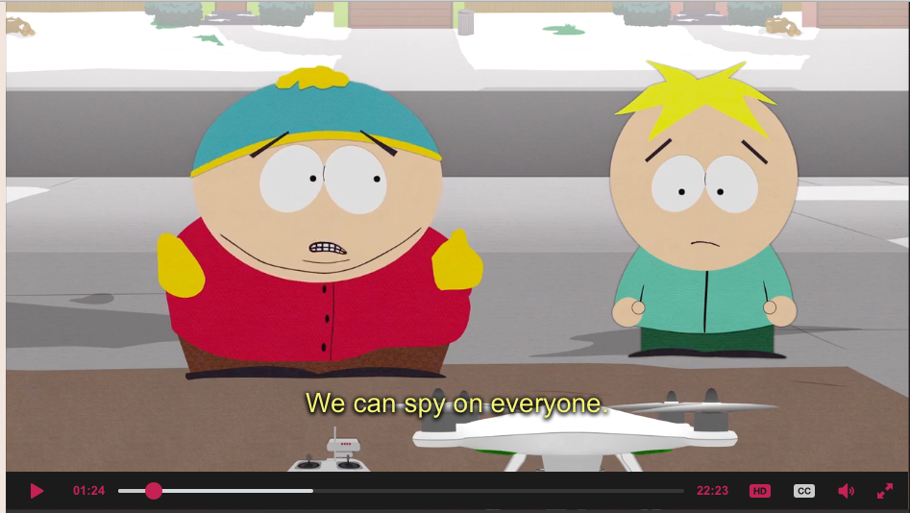
PRIVACY ISSUE
Drones have capacity to gather information about everyday lives, as well as the dangerous potential to encroach on privacy.
Drone industry advocates argue that these aircraft are not all that different from other technologies that could be used to conduct surveillance, and that state voyeurism and nuisance laws already in place will protect consumers
In the USA : New Jersey, Florida, Idaho, Illinois, Indiana, Iowa, Montana, Oregon, Tennessee, Texas, Utah, Virginia, and Wisconsin — 13 States have passed drone privacy laws.

Slide 24
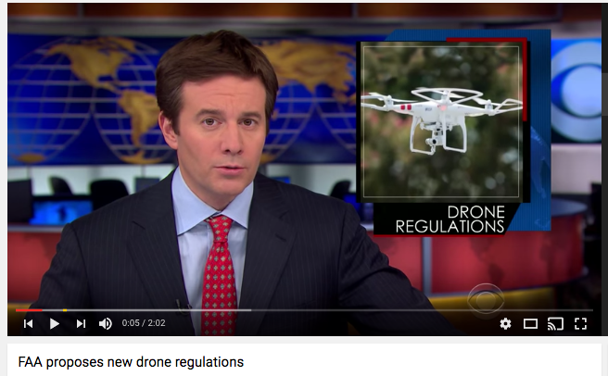
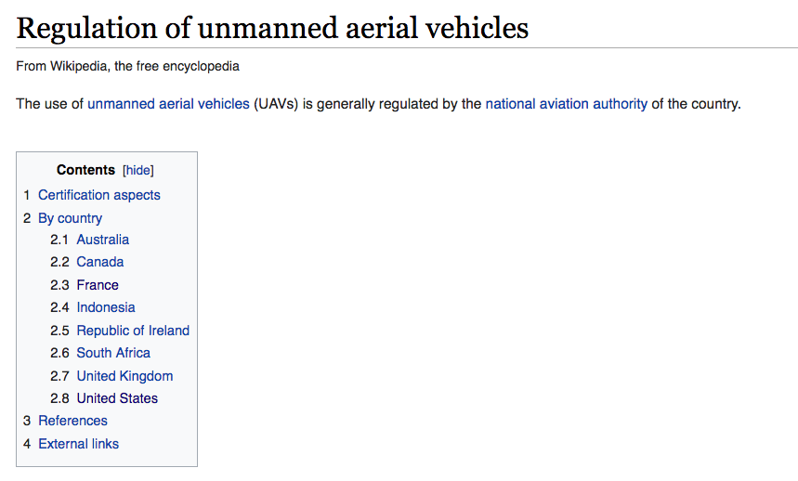
DRONE REGULATION
In the US, it is now required for all drone users to register drones weighing over 250 grams – a bit over half a pound. A drone can’t fly higher than 400 feet and can only fly during daylight hours.
The FAA (Federal Aviation Administration) has said it will regulate flights directly over crowds of people. Package delivery and other operations that involve flying beyond the operator’s line of sight are probably years away. Safety tests and air traffic control systems are needed.
Europe is still developing drone regulations, making it difficult to start commercial drone operations there.

Slide 25
HOW ?

Slide 26
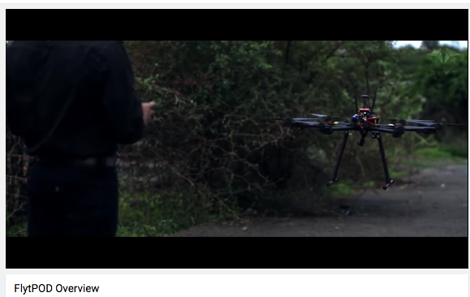
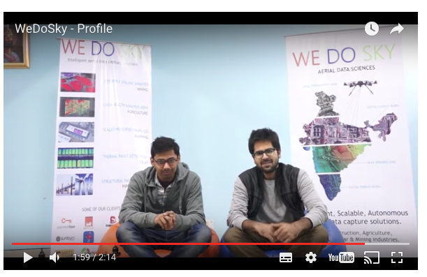
BE SA CREATIVE AS AN INDIAN START-UP
NavStik Labs is a startup working in the fields of computer vision and AI.
Airpix offers data gathering and analytics as a service using UAVs.
WeDoSky is working on technologies to make smart cities a reality. Its business model is mapped across two major components: WeDoSky (UAV as a service) and visualAI (SaaS).
Airwood is a UAV firm dedicated to Agri data and analytics. It has developed custom drones that gather field data which farmers can leverage using Airwood’s farm management dashboards.
Skylark Drones is an end-to-end drone as a solution firm for enterprises in infrastructure, mining, agriculture, utilities to oil & gas sectors.

Slide 27
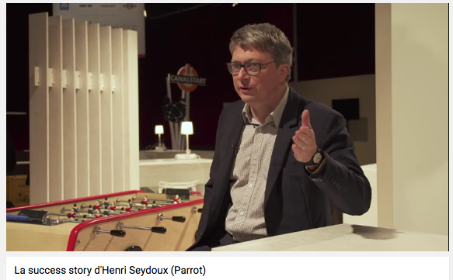
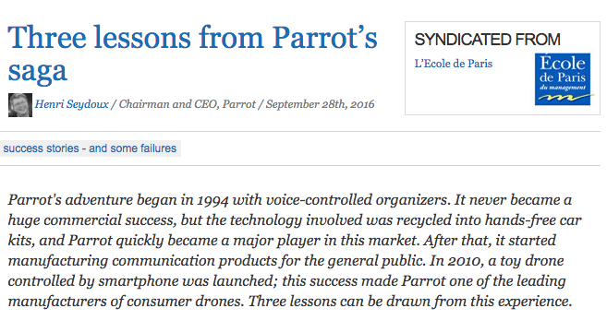
PARROT’s LESSONS
In 1994, Henry Seydoux created his own start-up, Parrot.
His ambition was to design a digital recorder with a voice recognition system.
The project of a toy drone piloted by a smartphone took Parrot five years of work.
In January 2010, Parrot introduced its first drone at the Consumer Electronics Show, in Las Vegas. It was a success.
In 2016, Parrot revenue reaches 330M€, including 200M€ in drones and 130M€ in the automotive sector.
To innovate, Seydoux created « internal start-ups »: with small talented teams with “two main prohibitions: no specifications, no market research”.
Some tinkering, trial and errors and “gradually, Parrot accumulates knowledge and sometimes, it ends up working”.

Slide 28
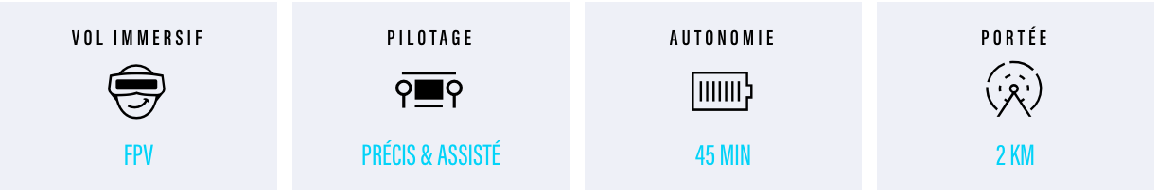
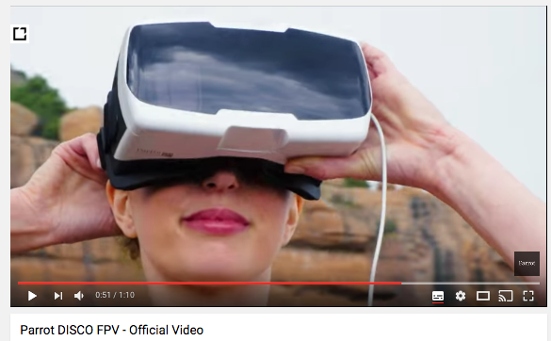
INNOVATE : PARROT DISCO FPV ( First Person View )
In 2016, Parrot launched Disco FPV
The first smart flying wing that reaches 80km/h.
Parrot Cockpitglasses: the essential goggles for immersive flights.
New Parrot Skycontroller 2.
https://www.parrot.com/fr/drones/parrot-disco-fpv#app
Price : 1299€

Slide 29
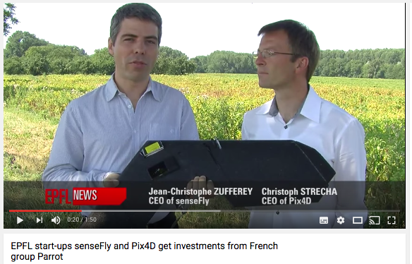
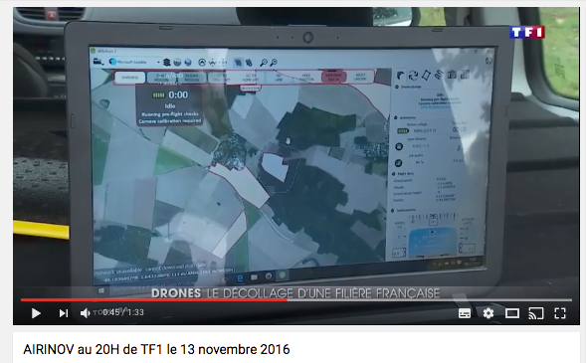
ACQUISITION : PARROT, SenseFly, Pix4D, Ari
July 2012, Parrot acquired for 5 million Swiss Francs a majority share in senseFly, a start-up from the Laboratory of Intelligent Systems at EPFL (Ecole Polytechnique Fédérale de Lausane)
Parrot also invested 2.4 million Francs in Pix4D, another EPFL spin-off active in the field of 3D image processing.
Parrot invested 1,6 M€ in Airinov in 2014

Slide 30
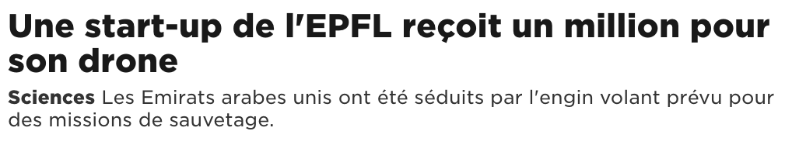
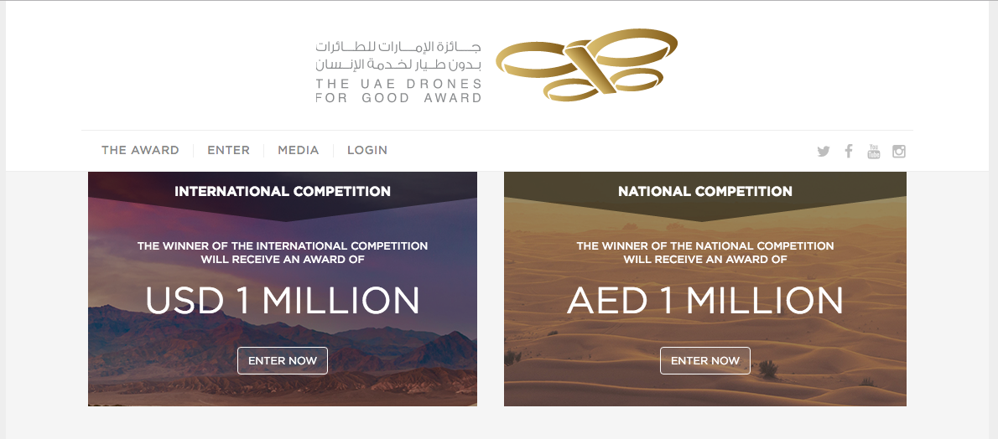
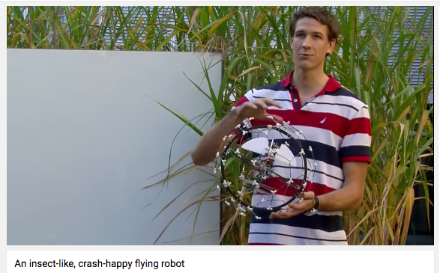
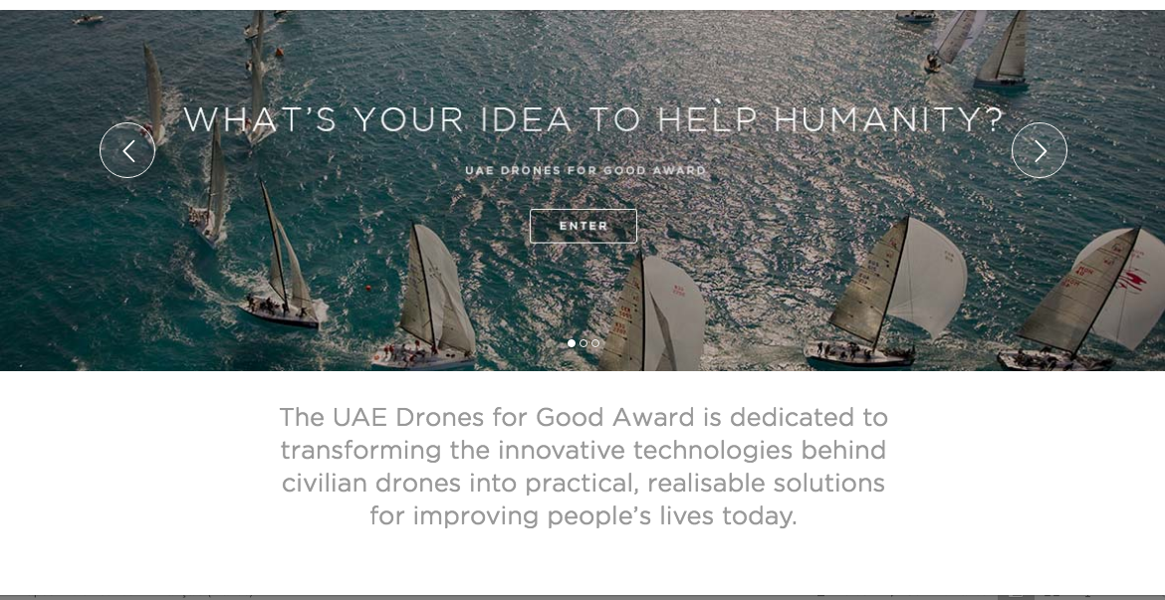
DRONES COMPETITION: THE UAE DRONES FOR GOOD AWARDS

Slide 31



PITCH A DRONE FUND :
Funds invests in businesses seeking financing to help advance their technology and grow business operations.
Investment areas include the following:
Sensor hardware — Sensor technology that will improve the precision, speed, cost or scale of what is possible with commercial drones.
Software applications — Software apps that make operating drones safer or enable new and innovative use cases for commercial drones.
Data analytics — Cloud-based software that makes analyzing and utilizing sensor data easier, more accessible, or more actionable.
Services — Drone-based services that provide unique business value for enterprises or open up drone use to an entirely new market.
Industry-specific solutions — Drone-based integrated solutions that help solve industry-specific challenges.

Slide 32



PITCH A DRONE FUND

Slide 33

AIRWARE COMERCIAL DRONE FUND
The Commercial Drone Fund was established to support businesses that are developing technologies and services that are critical to scaling the use of commercial drones across a variety of applications.
Jonathan Downey, Founder and CEO of Airware, is the General Partner of the Fund and has spent 10 years in the drone space - in academia at MIT, industry at Boeing, and building San Francisco-based commercial drone startup Airware.
Companies have access to a network of innovators, investors and Airware ecosystem partners to build key industry relationships. The first recipients: RedBird, Sky Futures, Cape, Raptor Maps.

Slide 34

SKYFUND
The SkyFund, backed by DJI and Accel, aims to fund entrepreneurs across a variety of application, hardware, peripheral and services categories where Unmanned Aerial Vehicles (UAVs), robotics and intelligent machines can make a meaningful impact.
Support entrepreneurs who are building the important technologies that drive UAVs into the hands of consumers and enterprises, across a spectrum of high-value use cases.
Advisors include leading hardware founders from Silicon Valley, key regulatory thought leaders who are actively in dialogue with the FAA, founders who have scaled high-growth technology businesses, and engineering leaders who understand developer platforms, APIs and SDKs.

Slide 35
COMPETITIVE ADVANTAGE
“Redbird is known in Europe for having the most advanced drone data analytics for mining, construction, and infrastructure inspection. Together with Airware and our partners, we’re ready to move to the next level and expand to the US – it’s a new step and a global development for our company,” Emmanuel de Maistre, co-Founder and CEO of Redbird.
“We’re excited to be working with Jonathan Downey and the Commercial Drone Fund to shape the future of commercial drone technology to save time, cut cost, and improve safety for industry. Our solutions are already in use with over 35 of the biggest oil and gas companies globally. Investment from the Commercial Drone Fund will speed up the delivery of our technology roadmap and create more valuable data to our existing client base faster.” James Harrison, co-founder and CEO of Sky-Futures

Slide 36


FOR YOUR BUSINESS : CHOOSE A PLATFORM

Slide 37


PLATFORM AIRWARE

Slide 38
IMPACTS ?

Slide 39


DRONE VALUE

Slide 40

IMPACT ON TRANSPORT
Australia (Australian Post in 2015), Switzerland (Swiss Post in 2015), Germany (DHL Deutsche Post in 2014), Singapore (SingPost in 2015) and Ukraine (Ukrposhta in 2016) have tested the feasibility and profitability of unmanned delivery drone services.
Cost effectiveness, emergency situation; rural,moutain island deliveries.

Slide 41

IMPACT ON SUPPLY CHAIN
Drones have been used inside large warehouse buildings to measure inventory using barcode, Q-code, RFID and other Internet of Things techniques.

Slide 42

IMPACT ON MANUFACTURING
Audi Smart Factory: Drones are already transporting steering wheels from one place to another.

Slide 43



IMPACT ON DANGEROUS WORK
Sky-Futures enables enterprise to perform safe and cost effective drone inspections of a variety of vertical infrastructures, including but not limited to the following industries: Oil and Gas; Renewables; Utilities; Telecoms; Bridges; and Construction.

Slide 44

IMPACT ON TELECOM INDUSTRY
Telecom companies use drones to conduct tower inspections.
Drones enable the safe, quick and comprehensive inspection of these towers, keeping workers’ feet on the ground by putting drones in the air
Cell tower inspections are one of the most dangerous jobs in the world.

Slide 45

IMPACT ON E-COMMERCE : ALIBABA
The business model is pretty simple – delivery quality goods swiftly and at a low price.
Increase client satisfaction is the promise of speedy delivery.
Brand will be recognized as a revolutionary in product delivery.
It will portray the company as an environmentally conscious brand. With drone delivery systems, fewer transportation carriers will be traveling on roads and polluting the atmosphere.
Regulations actually pose severe obstacles.

Slide 46


IMPACT ON E-COMMERCE : JD.COM
Chinese e-commerce company JD.com has revealed the country’s first operational pilot program for drone deliveries, as tech firms compete to reach the country’s untapped rural consumers.
Currently the drones fly exclusively between depots before being distributed to “village promoters”, who then manage the final package deliveries.
JD.com has no intention of delivering directly to people’s houses.

Slide 47
IMPACT ON MARKETING
Drones as a physical medium: they are used to physically reach consumers in new and innovative ways.
Drones as actors: they are used by marketers in video commercials as surprising flying objects bringing the “wow” factor.
Drones as videographer tools: they are used in commercials to produce innovative video content and offer new perspectives.
Drones as a hub of emerging technologies: integrated with other technologies (such as VR/AR, cloud, IoT…), drones are opening the path to disruptive ways to gather data and market to target audiences.

Slide 48



IMPACT ON MARKETING : PHYSICAL MEDIUM
the “dronequins” to inform the office workers and passers-by of special offers available on Black Friday. Brazil.
FunnyHowFlowersDoThat, an initiative from the Flower Council of Holland. Italy.
Launch of the new 2016 Infiniti QX30 model at the Los Angeles Auto Show in 2015. USA

Slide 49



IMPACT ON MARKETING: DRONES AS ACTOR
Coca Cola 2014 Happiness from the Skies campaign. 578 238 vues on YouTube.
Drones were used as the “villain” in the spot produced by Audi to launch their Audi 6 model in March 2015.
Pepsi Max’s viral videos, created for the #LiveForNow campaign
8 042 403 vues on YouTube.

Slide 50


IMPACT ON MARKETING : VIDEOGRAPHER TOOLS
Used for film or video “drones offer a different perspective that captures people’s attention.
They allow marketers to be more creative and innovative by using angles and shots that weren’t previously practical–often at a much lower cost.
Aerial MOB‘s clients are some of the biggest entertainment and media companies in the world like BBC, HBO, MTV and Warner Brothers, car companies like KIA, Peugeot, Hyundai, Infiniti and BMW and consumer brands like NIKE and Converse. http://aerialmob.com/

Slide 51

IMPACT ON MARKETING : HUB OF EMERGING TECHNOLOGIES
Cloud, Big Data, Artificial Intelligence, Machine Learning, Virtual Reality, Internet of Things, Wearable Technologies: each of these technologies will be cross-pollinated with drones, and each of them will have a huge impact on the potential of drones in marketing.
The Art of Patron VR Experience is an immersive virtual reality experience based on Oculus technology and drone videos to promote the Mexican brand Patrón.

Slide 52



IMPACT ON ENTERTAINEMENT
Aerial photography and filming.
Key benefits of a drone is that it can capture images and video with more flexibility and at a tiny fraction of the cost of a helicopter.
Sam Mendes’ Skyfall was the first of the James Bond movies to use drones for filming aerial footage.
Patent registered by Disney, which intends to use drones for live shows at its theme parks.

Slide 53

IMPACT ON INSURANCE
With a drone, data and photos can be collected with more details and quickly.
Use of more sophisticated sensors, such as thermal (IR) cameras, which are useful for detecting water damage, or laser measuring units (LIDAR) that can provide detailed models of a building or the slope of a property for drainage during flood scenarios.
By lowering the time to inspect a loss, and the number of losses, drones directly impact the speed with which customers are able to receive settlements.
Reduction of the fraud.

Slide 54


IMPACT ON MAINTENANCE
Airlines Air France KLM, Easyjet and Lufthansa have adopted drones as a tool for aircraft inspections.
Inspecting the outside of massive airplanes like the Airbus A380 superjumbo can take hours.
A drone can inspect an A380 aircraft in just 10-15 minutes. In this time, the drone takes over one hundred photos of the aircraft.

Slide 55

IMPACT ON CONSTRUCTION AND MINING
Construction and mining companies use drones to optimize efficiency, trim costs and monitor site compliance
Mining giant Rio Tinto is using drones to survey equipment and mining pits in Western Australia.
Caterpillar is reportedly exploring the use of drones for fleet vehicle management in the field.
Drones are the cornerstone of Komatsu’s “Smart Construction” service.

Slide 56


IMPACT ON AGRICULTURE
Drones can assess soil, monitor crop health, apply fertilizers, even track weather and estimate yields, and then collect the data and analyze it for prompt action.
Bank of America Merrill Lynch projects agriculture to make up almost 80 percent of the commercial drone market in the future, with the potential to generate $82 billion worth of economic activity in the U.S. between 2015 and 2025.
Goldman Sachs predicts the agriculture sector to be the largest user of drones in the U.S. and the second largest in the world in the next five years.
Research company Markets and Markets estimates the agricultural drone market to grow at a compounded average rate of 30 percent through 2022.

Slide 57


IMPACT ON AGRICULTURE
Reveal patterns that expose everything from irrigation problems to soil variation and even pest and fungal infestations.
Take multispectral images, capturing data from the infrared as well as the visual spectrum, which can be combined to create a view of the crop that highlights differences between healthy and distressed.
A drone can survey a crop every week, every day, or even every hour. Combined to create a time-series animation, that imagery can show changes in the crop, revealing trouble spots or opportunities for better crop management.

Slide 58


IMPACT ON ENVIRONMENT
Low emissions: Commercial Drone do not produce the high levels of CO² associated with planes and helicopters. This makes them a more environmentally friendly alternative.
Environmental conservation projects : Ideal for environmental observation projects from monitoring and mapping natural landscapes to tracking animal migration patterns.
Energy projects :The energy industry is already using drones for a huge range of applications such as monitoring pipelines, wind turbines and solar farms.

Slide 59


IMPACT ON HEALTH
December 2016, Johns Hopkins University transported small amounts of blood by flying machine and found that, when unpacked at the destination, the delivery was usable for transfusions.
May 2016, Zipline’s drones will be used to deliver blood, plasma, and coagulants to hospitals across rural western Rwanda, helping to cut waiting times from hours to minutes.

Slide 60

IMPACT ON HEALTH
Each year nearly a million people in Europe suffer from a cardiac arrest.
A mere 8% survives due to slow response times of emergency services.
The ambulance-drone is capable of saving lives with an integrated defibrillator. The goal is to improve existing emergency infrastructure with a network of drones.

Slide 61


IMPACT ON HUMANITARIAN AID
When Typhoon Hagupit hit the Philippines in December 2014, Aeryon Labs offered a drone to disaster response charity, Global medic. Using the drone, Global Medic was able to capture a series of images to create a map of the affected area and help response teams focus their relief efforts.
After the 2015 earthquake in Nepal, DJI and Pix4D’s Intent of building a community of Nepali UAV operators skilled in imagery analysis to

Slide 62




IMPACT ON SECURITY
Law enforcement organizations are using drones more than ever.
Companies have found ways to modify both consumer and military drones for police use.
Drones could be used during riots, surveillance.

Slide 63


